Slide 1
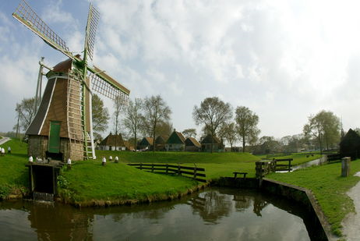
Global Site Foundation
Dolf Dijkstra
April 2011
Staying close to your roots

Slide 2

Microsite
<%@ taglib prefix="cs" uri="futuretense_cs/ftcs1_0.tld“
%><%@ taglib uri="http://java.sun.com/jsp/jstl/core" prefix="c“
%><%@ taglib uri="http://gst.fatwire.com/foundation/tags/gsf" prefix="gsf“
%><cs:ftcs><gsf:root>
<gsf:asset-load name="wra" attributes="metatitle,metadescription,metakeyword,h1title,linktext,body" />
<html><head>
<meta name="title" content='${wra.metatitle}' />
<meta name="description" content='${wra.metadescription}' />
<meta name="keyword" content='${wra.metakeyword}' />
<title>${wra.metatitle} | ${cs.site}</title>
</head><body>
<div id="nav"><gsf:navigation name="nav" depth="1" pagename="MainNav"/>
<ul>
<c:forEach var="kid" items="${nav.children}">
<li><a href='${kid.url}'>${kid.linktext}</a></li>
</c:forEach>
</ul>
</div>
<p>Current date is <strong><%= new java.util.Date()%></strong></p>
<h1>${wra.h1title}</h1>
<div class="articlebody">${wra.body}</div>
</body>
</html>
</gsf:root></cs:ftcs>

Slide 3
gsf://architecture
Filter
Satellite
disassembler
ContentServer
XML element
Controller
ActionLocator
Action
Template

Slide 4
gsf://code conventions
Facades
Builders
Helpers
Sitting on the thrown: Runtime exceptions
Jsp tags
Lifecycle follows ics for most classes

Slide 5
gsf://how to get it
http://gsf.fatwire.com
Svn http://www.nl.fatwire.com/svn/dta/contrib/gst-foundation
Maven repo http://www.nl.fatwire.com/maven2/com/fatwire/gst/gst-foundation-all/

Slide 6

gsf://building from source
http://tortoisesvn.net/downloads.html
http://maven.apache.org/download.html
JDK1.6
Eclipse: set mvn into workspace
mvn -Declipse.workspace=<path-to-eclipse-workspace> eclipse:add-maven-repo
Adding cs jars

Slide 7

gsf://install
Follow the guide
Install via the GST/Foundation/Install element.
Add jstl

Slide 8
gsf://code dive
~175 classes
com.fatwire.gst.foundation
Developer productivity
Learning curve
Common problems solved
Bridging asset API and ICS world
Extendable
Portable

Slide 9
Where to find sample code
Look at source code.
Look at test cases.
Use CS documentation.

Slide 10

com.fatwire.gst.foundation.facade.runtag
The missing java api
TagRunner
AbstractTagRunner
TagRunnerRuntimeException
Executes the tag via ics.runtag
order is
bind(ics);
preExecute();
ics.runTag();
postExecute();
handleError() if runTag or postExecute set errno to anything else then zero.

Slide 11
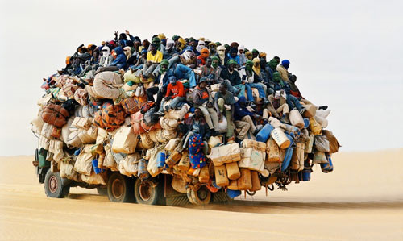
Setters and Getters
Setters are overloaded
set(String)
set(Long)
set(AssetId)
Getters are precise
getString()
getLong()
In CS this is mostly reverse ☹

Slide 12

com.fatwire.gst.foundation
CSRuntimeException
DebugHelper
IListUtils

Slide 13
com.fatwire.gst.foundation.facade
FTValListFacade
.ics.ICSFactory
public AliasCoreFieldDao() {
this(ICSFactory.getOrCreateICS());
}
public AliasCoreFieldDao(ICS ics) {
this.ics = ics;
wraCoreFieldDao = new WraCoreFieldDao(ics);
}

Slide 14
Inserting a row with CatalogManager
FTValList vl = new FTValList();
vl.setValString("ftcmd", "addrow");
vl.setValString("tablename", TAGREGISTRY_TABLE);
vl.setValString("id", ics.genID(true));
vl.setValString("tag", tag.getTag());
vl.setValString("assettype", id.getType());
vl.setValString("assetid", Long.toString(id.getId()));
if (asset.getStartDate() != null)
vl.setValString("startdate", Util.formatJdbcDate(asset.getStartDate()));
if (asset.getEndDate() != null) vl.setValString("enddate", Util.formatJdbcDate(asset.getEndDate()));
if (!ics.CatalogManager(vl) || ics.GetErrno() < 0) {
throw new CSRuntimeException("Failure adding tag to tag registry", ics.GetErrno());
}

Slide 15
com.fatwire.gst.foundation.facade.cm
CatalogManager façades
FTCmdTemplate
AddRow
UpdateRow
UpdateRows
AddRow r = new AddRow(TAGREGISTRY_TABLE);
r.set("id", ics.genID(true));
r.set("tag", tag.getTag());
r.set("assettype", id.getType());
r.set("assetid", id.getId());
r.set("startdate", asset.getStartDate());
r.set("enddate", asset.getEndDate());
r.execute(ics); //exception thrown on fail

Slide 16
com.fatwire.gst.foundation.facade.sql
AbstractIList
IListIterable
Row
SingleRow
SqlHelper
StatementParam param = REGISTRY_SELECT_ID.newParam();
param.setString(0, id.getType());
param.setLong(1, id.getId());
Row row = SqlHelper.selectSingle(ics, REGISTRY_SELECT_ID, param);
row.getString(key)
row.getLong(key);

Slide 17

IListIterable
for (Row r : new IListIterable(iList)) {
result.add(r.getLong("id"));
}

Slide 18
com.fatwire.gst.foundation.facade.sql.table
TableDef
TableColumn
TableColumn$Type
TableCreator
TableDef def = new TableDef(TAGREGISTRY_TABLE, TABLE_ACL_LIST, "obj");
def.addColumn(new TableColumn("tag", TableColumn.Type.ccvarchar).setLength(255).setNullable(false));
def.addColumn("assettype", TableColumn.Type.ccvarchar).setLength(255).setNullable(false);
def.addColumn("assetid", TableColumn.Type.ccbigint).setNullable(false);
def.addColumn("startdate", TableColumn.Type.ccdatetime).setNullable(true);
new TableCreator(ics).createTable(def);

Slide 19
Sample TagRunner
AssetLoadById assetLoad = new AssetLoadById();
assetLoad.setAssetId(p);
assetLoad.setAssetType("Page");
assetLoad.setName(LOADED_PAGE_NAME);
assetLoad.execute(ics);
You have to work with the ics.GetObj(LOADED_PAGE_NAME);
Familiar, cumbersome?

Slide 20

Les autres
.runtag.asset
.runtag.assetset
.runtag.commercecontext
.runtag.listobject
.runtag.mail
.runtag.render
.runtag.siteplan
.runtag.user
.runtag.vdm
.runtag.vdm.GetAlias
.runtag.vdm.SetAliasWithoutReset
.runtag.xlat

Slide 21
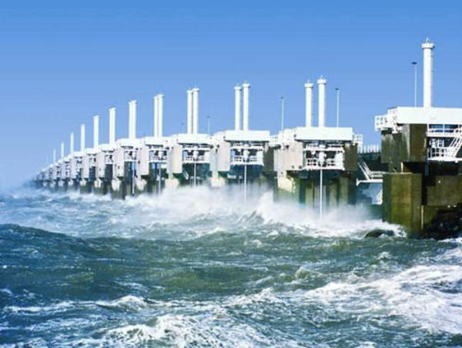
The Render stuff
CallElement
CallTemplate
CallTemplate$Style
CallTemplate$Type
GetBlobUrl
GetPageUrl
GetTemplateUrl
LogDep
LogDep$DependencyType
Unknowndeps

Slide 22
CallTemplate enhancements
Configuration:
com.fatwire.gst.foundation.facade.runtag.render.CallTemplate
.style
.override
.config_FixPageCriteria
ProposeStyle (is currently caching, is target caching, is cid different)
Check and fixPageCriteria
Context=“”
// consider to set site to ics.GetVar("site"); as helper

Slide 23
The Render future
Render.ContentServer is missing
Make it simpler and less error prone
Include.template()
Include.element()
Include.page()
<gsf:include/>

Slide 24
com.fatwire.gst.foundation.facade.assetapi
AssetDataUtils
public static AssetData getAssetData(AssetId id, String... attributes) {
AssetDataManager mgr = (AssetDataManager) getSession().getManager(AssetDataManager.class.getName());
try {
return mgr.readAttributes(id, Arrays.asList(attributes));
} catch (AssetAccessException e) {
throw new CSRuntimeException("Failed to read attribute data: "+e, ftErrors.exceptionerr, e);
}
}
AssetIdIList
AssetIdUtils
RuntimeAssetAccessException

Slide 25
AttributeDataUtils
static public List<?> asList(AttributeData attr) {
Object o = attr == null ? null : attr.getData();
if (o == null)
return null;
if (isSingleValued(attr)) {
throw new RuntimeException("not a multi valued attribute");
}
return attr.getDataAsList();
}
public static String getWithFallback(AssetData assetData, String... orderedAttributeNames)

Slide 26
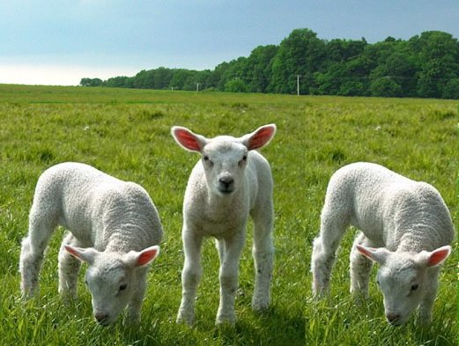
AssetAccessTemplate
Modelled after Spring Templates (jdbc/ldap)
AssetAccessTemplate
AssetClosure
AssetMapper

Slide 27
AssetClosure
Do something with a list
public void readAssets(final Query query, final AssetClosure closure) {
final AssetDataManager m = getAssetDataManager();
try {
for (AssetData asset : m.read(query)) {
closure.work(asset);
}
} catch (final AssetAccessException e) {
throw new RuntimeAssetAccessException(e);
}
}

Slide 28
AssetClosure sample
Query q =…;
AssetAccessTemplate aat=…;
AssetClosure closure = new AssetClosure(){
public void (AssetData asset){
System.out.println(asset);
}
}
aat.readAssets(q,closure);

Slide 29
AssetMapper
How to get from AssetData to a bean?
public interface AssetMapper<T> {
T map(AssetData assetData);
}
Input for AssetAccessTemplate.
Sample in TableTaggingServiceImpl

Slide 30
Sample AssetMapper (old code)
private TaggedAsset loadTaggedAsset(AssetId id) {
AssetData data = AssetDataUtils.getAssetData(id, "startdate", "enddate", "gsttag");
Date startDate = AttributeDataUtils.asDate(data.getAttributeData("startdate"));
Date endDate = AttributeDataUtils.asDate(data.getAttributeData("enddate"));
TaggedAsset ret = new TaggedAsset(id, startDate, endDate);
for (String tag : AttributeDataUtils.getAndSplitString(data.getAttributeData("gsttag"), ",")) {
Tag oTag = asTag(tag);
recordCacheDependency(oTag);
ret.addTag(oTag);
}
return ret;
}

Slide 31
Sample AssetMapper (new code)
private AssetMapper<TaggedAsset> mapper = new AssetMapper<TaggedAsset>(){
public TaggedAsset map(AssetData data) {
Date startDate = AttributeDataUtils.asDate(data.getAttributeData("startdate"));
Date endDate = AttributeDataUtils.asDate(data.getAttributeData("enddate"));
TaggedAsset ret = new TaggedAsset(data.getAssetId(), startDate, endDate);
for (String tag : AttributeDataUtils.getAndSplitString(data.getAttributeData("gsttag"), ",")) {
Tag oTag = asTag(tag);
ret.addTag(oTag);
}
return ret;
}
};

Slide 32
Sample AssetMapper (refactored)
Readable Code
private TaggedAsset loadTaggedAssetNew(AssetId id) {
LogDep.logDep(ics, id);
AssetAccessTemplate aat = new AssetAccessTemplate(ics);
TaggedAsset ret = aat.readAsset(id, mapper , "startdate", "enddate", "gsttag");
for (Tag tag : ret.getTags()) {
recordCacheDependency(tag);
}
//recordCacheDependency(ret) would even be better
return ret;
}

Slide 33
com.fatwire.gst.foundation.facade.assetapi
For use in java classes called from CS Templates
TemplateAsset
lazy loaded
as methods
TemplateAssetMapper
The Template class is missing (need a good name)

Slide 34

com.fatwire.gst.foundation.facade.assetapi
AssetMapAdapter: asset as a Map (JSTL)
MappedAssetAccessTemplate (deprecated)
ScatteredAsset: a Map and attributes loaded
ScatteredAssetAccessTemplate: the real meat!

Slide 35
ScatteredAssetAccessTemplate
final ScatteredAssetAccessTemplate t = new ScatteredAssetAccessTemplate(ics);
ScatteredAsset asset =t.readCurrent(); // where are c/cid/attributes??
AssetId id =…’
ScatteredAsset other = t.read(id, “name”,”h1title”));
Collection<ScatteredAsset> products = t.readAssociatedAssets(ics.GetVar("c"), ics.GetVar("cid“), "requiresProduct");
Collection<ScatteredAsset> products = t.readAssociatedAssets(ics.GetVar("c"), ics.GetVar("cid“), "requiresProduct“,”name”,”body”);
Collection<AssetId> productIds = t.readAssociatedAssetIds("requiresProduct");

Slide 36
com.fatwire.gst.foundation.facade.assetapi
Doing Queries
ConditionParser
name='foo’
name = 'foo’
name = foo
name= 'foo bar’
size=[1,2] (OR condition)
size{10,250} (between)
name!='foo’
QueryBuilder
Query q = new QueryBuilder(assetType, subType).condition(query).attributes(attributes).toQuery();
Iterable<ScatteredAsset> list= readAssets(q, mapper);

Slide 37
com.fatwire.gst.foundation.facade.uri
BlobUriBuilder
PageUriBuilder
TemplateUriBuilder
BlobObject blob=…
String uri=new BlobUriBuilder(blob)
.mimeType("image/jpeg")
.parent("12345").toURI(ics);
We should add variant asset and attribute name: ScatteredAsset or AssetData?

Slide 38
com.fatwire.gst.foundation.tagging
Tag
TagUtils
AssetTaggingService
.db.TableTaggingServiceImpl
AssetTaggingServiceFactory
CacheMgrTaggedAssetEventListener
TaggedAssetEventListener
TaggedAssetRealtimeCacheUpdater

Slide 39

com.fatwire.gst.foundation.wra.navigation
NavigationHelper
NavNode
AssetAccessTemplate assetTemplate = new AssetAccessTemplate(ics);
AssetId pageid = assetTemplate.findByName(ics, "Page", name);
NavigationHelper nh = new NavigationHelper(ics);
NavNode node= nh.getSitePlan(depth, pageid);

Slide 40
com.fatwire.gst.foundation.controller
AbstractController
BaseController
AssetIdWithSite

Slide 41
com.fatwire.gst.foundation.httpstatus
Google wants a 404
CustomHeaderFilter
HttpStatusStrings
StatusFilterHttpResponseWrapper

Slide 42
com.fatwire.gst.foundation.url
How to get to those nice Vanity URLs.
WraPageReference (PageRef)
.db.UrlRegistry
LightweightAbstractAssembler
WraPathAssembler
WraAssetEventListener
WraPathTranslationService
WraPathTranslationServiceFactory

Slide 43
com.fatwire.gst.foundation.vwebroot
VirtualWebroot
VirtualWebrootDao
VWebrootBeanImpl

Slide 44
com.fatwire.gst.foundation.wra
Alias
AliasBeanImpl
AliasCoreFieldDao
WebReferenceableAsset
WraBeanImpl
WraCoreFieldDao
WraUriBuilder

Slide 45
com.fatwire.gst.foundation.facade.search
SimpleSearchEngine
SearchResultIterable

Slide 46
Microsite
<%@ taglib prefix="cs" uri="futuretense_cs/ftcs1_0.tld"%>
<%@ taglib uri="http://java.sun.com/jsp/jstl/core" prefix="c"%>
<%@ taglib uri="http://gst.fatwire.com/foundation/tags/gsf" prefix="gsf"%>
<cs:ftcs><gsf:root>
<gsf:asset-load name="wra" attributes="metatitle,metadescription,metakeyword,h1title,linktext,body" />
<html><head>
<meta name="title" content='${wra.metatitle}' />
<meta name="description" content='${wra.metadescription}' />
<meta name="keyword" content='${wra.metakeyword}' />
<title>${wra.metatitle} | ${cs.site}</title>
</head><body>
<div id="nav"><gsf:navigation name="nav" depth="1" pagename="MainNav"/>
<ul>
<c:forEach var="kid" items="${nav.children}">
<li><a href='${kid.url}'>${kid.linktext}</a></li>
</c:forEach>
</ul>
</div>
<p>Current date is <strong><%= new java.util.Date()%></strong></p>
<h1>${wra.h1title}</h1>
<div class="articlebody">${wra.body}</div>
</body>
</html>
</gsf:root></cs:ftcs>

Slide 47
JSP taglib
<%@ taglib uri="http://gst.fatwire.com/foundation/tags/gsf" prefix="gsf" %>
<gsf:asset-load name="wra" attributes="metatitle,metadescription,metakeyword,h1title,linktext,dateadded,mimetype,website,summary,category" />
assetDao like ics , is ScatteredAssetAccessTemplate

Slide 48
GSF taglib
tagged-list
tagged-assets
asset-tagged-list
asset-load
asset-children
asset-query
navigation
root

Slide 49
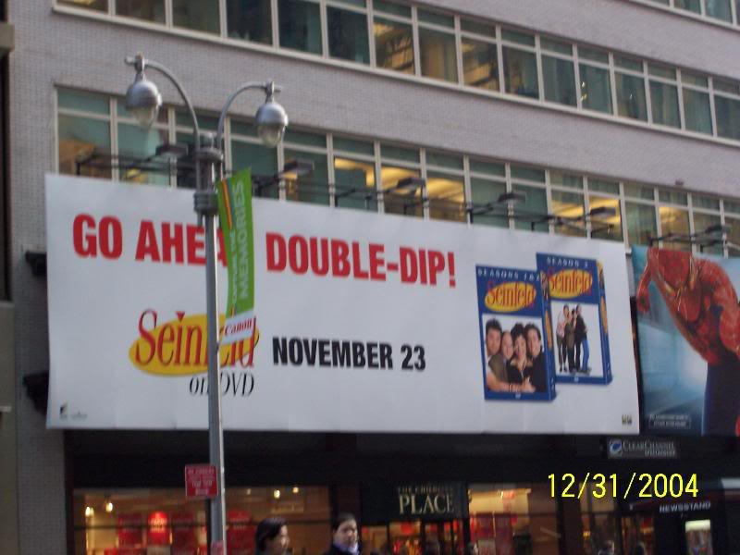
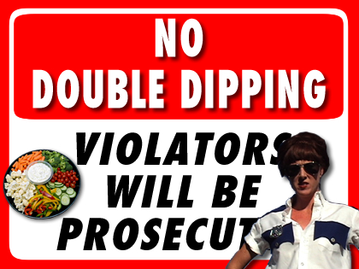
DeveloperNet: experimental
Move business logic to java
Factoring & Wiring
Integrated with Spring framework
Double dippin’

Slide 50
com.fatwire.gst.foundation.controller.action
Action
ActionController
ActionLocator
AnnotationInjector
AttributeActionLocator
CommandActionLocator
IcsBackedObjectFactoryTemplate
RenderPage
GSFContext
IcsBackedObjectFactory
WEB-INF/gsfApplicationContext.xml

Slide 51
com.fatwire.gst.foundation.controller.annotation
Using @annotations for controller and injection
AnnotationController
ControllerMappingResolver
IcsVariable
InjectForRequest
We need @provider and component scanning

Slide 52
com.fatwire.developernet.controller
These are actions
Login
ProtectedRenderPage

Slide 53
com.fatwire.developernet.visitor
Visitor
VisitorDao
VisitorManager
Not the Engage visitor

Slide 54
com.fatwire.developernet.visitor.ldap
Spring wired
LdapVisitorDao
LdapAuthenticator
IcsLdapPasswordVisitorManager
LdapTemplateRetryWrapper

Slide 55

gsf://groovy
Groovy is a scripting language
Dynamic reloading
Java syntax
Actions for now

Slide 56
com.fatwire.gst.foundation.groovy.spring
Spring wired
GroovyLoader
GroovyActionLocator
Double Dippin’

Slide 57
gsf://how to contribute
Mail Tony or Dolf
Get an svn account
Branch
Please don’t copy GSF into customer name space

Slide 58
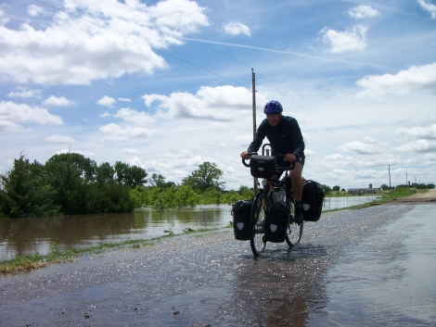
gsf://code walk DevNet
How simple it can be

Slide 59
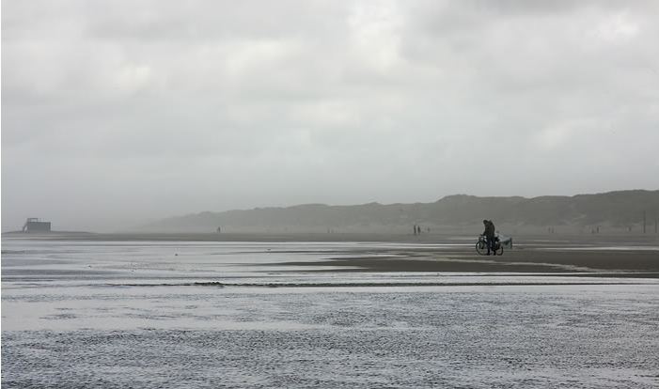
Site Configuration
How is this done, what works?
Asset (basic/flex)
Db table?
Properties file
Combine these?

Slide 60
The ultimate asset family
For brochure ware
Web pages
Article
Image
Media/Download (pdf/ppt)
Flash
What else?
Which attributes

Slide 61
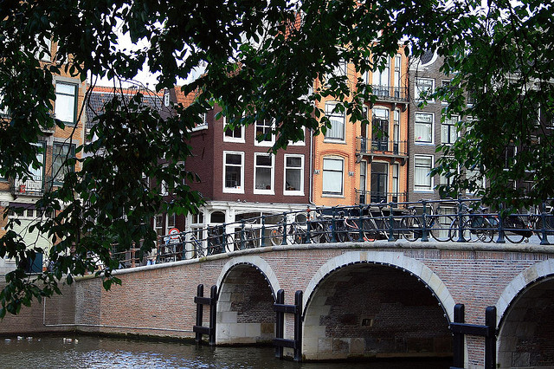
Modules
How to place functionality to a site
Login
Search
Most Popular
Related items

Slide 62
Parametric search module
Has this been done?

Slide 63
Asset filtering
Locales
More generic framework
AssetClosure can be your friend

